Slide 1
Customer Analytics from CFPB Database on the Credit Card Industry
Natasha Medina
Capstone Project Springboard

Slide 2
Business Objective:
Analyze CFPB’s online reviews and ratings on the Credit Card Industry
Conduct data mining methods on the CFPB customer complaint data for actionable insights
Relating to financial service products
including reasons for those complaints
actions financial institutions are taking to resolve them
Identify business processes that could be improved for the Credit Card Industry in Financial Sector

Slide 3
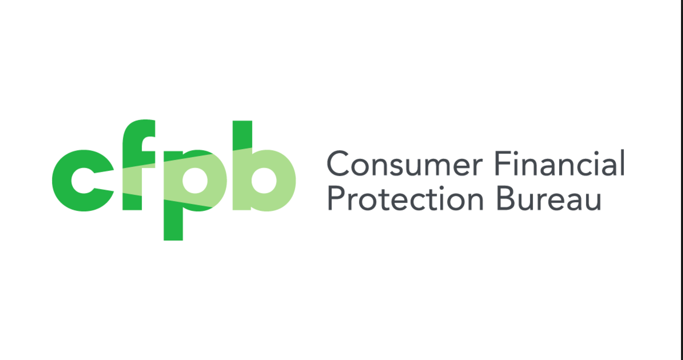
Data Source
16,795 CFPB customer online reviews
Review comments
Review response times

Slide 4
Techniques & Tools
Analytics Techniques
Word Cloud Analysis
Association Analysis
Sentiment Analysis
Analytics Tools
Statistical Programming Language: R
Package ”dplyr”
Package “pylr”
Package “tidyr”
Package “ggplot2”
Package “tm”
Package “wordcloud”
Package “wordlcoud”
Package “syuzhet”
Package “scales”
Package “scales”
Package ”SnowballC”
Package “sentimentr”
Package “Amelia”
Package “RColorBrewer”

Slide 5
Data Science Process
Data Wrangling and Pre-Processing
TMpackage, Removing white space, stop words, strings and Stemming
Data Analysis:
ggplot2, tm, wordcloud, syuzhet
Data Cleaning:
dplyr, tidyr, grepl

Slide 6
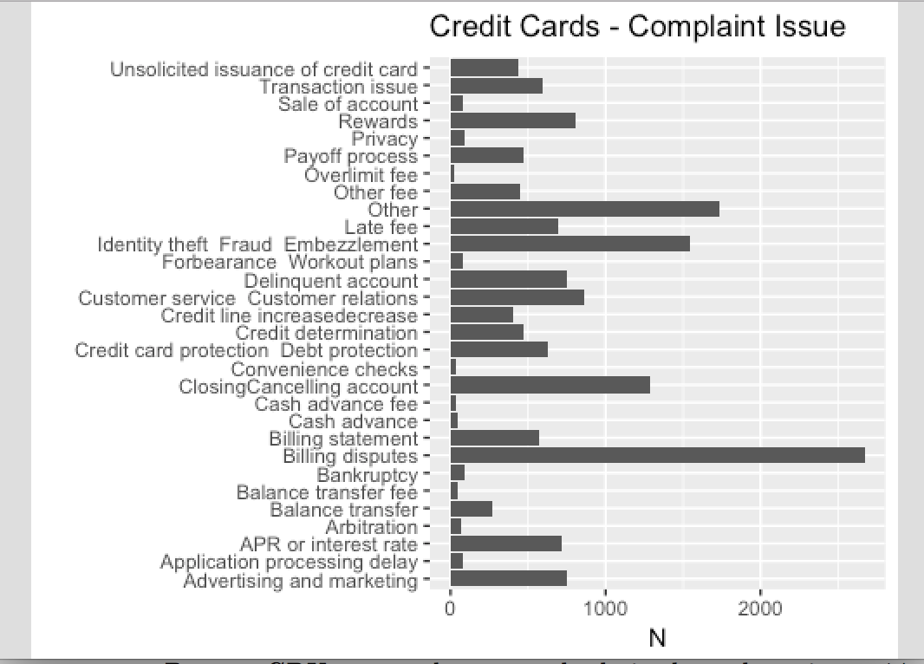
Customer Top Complaints on Credit Card Industry
The most consumer issues represented were related to billing disputes which accounted for 16.1 percent for credit card companies.
Consumer report issues with fraudulent charges: Consumer describe difficulties in having these charges removed even after notification from their card company that the dispute had been resolved in their favor.

Slide 7
Customer Top Complaints on Credit Card Industry
Insights:
Consumers complained about the application of payments to their accounts with multiple balances and different expiration periods that resulted from balance transfers, cash advances, or deferred internet purchases.
Also, it seems that consumers complained of difficulty understanding determinations made by credit card companies and the reasons stated on letters explaining the decisions.

Slide 8
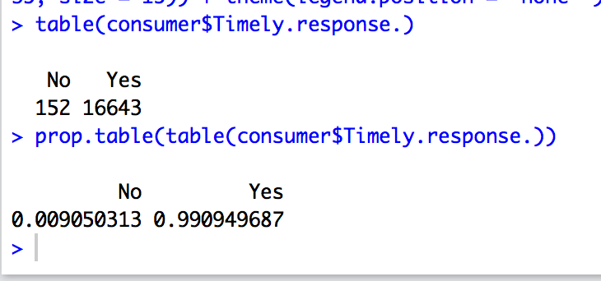
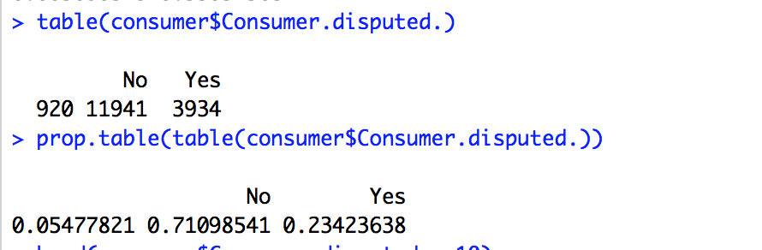
Complaint Resolution Response Time
Almost 99% of complaints have been addressed timely.
Second graph: consumer disputed
CFPB showed that financial institutions are responding faster to customer complaints.
Firms have reduced their untimely response rate.
How many complaints have received timely response?

Slide 9
Top Companies with Highest Complaints
Over 2,000 complaints Citibank receives
Outlier out of all big banks
Lowest Amount of Complaints U.S. less than 1,000

Slide 10
Highest Number of Complaints by State
Most highly populated states receive highest number of complaints (CA, NY, FL, TX)
After Texas, there is a shift of decreasing number of complaints from NJ to NC by 1,000 complaints

Slide 11
Lowest Number of Complaints by State
The least populated states receive highest number of complaints (ND, SD, WY)
The graph is positively skewed to the right

Slide 12
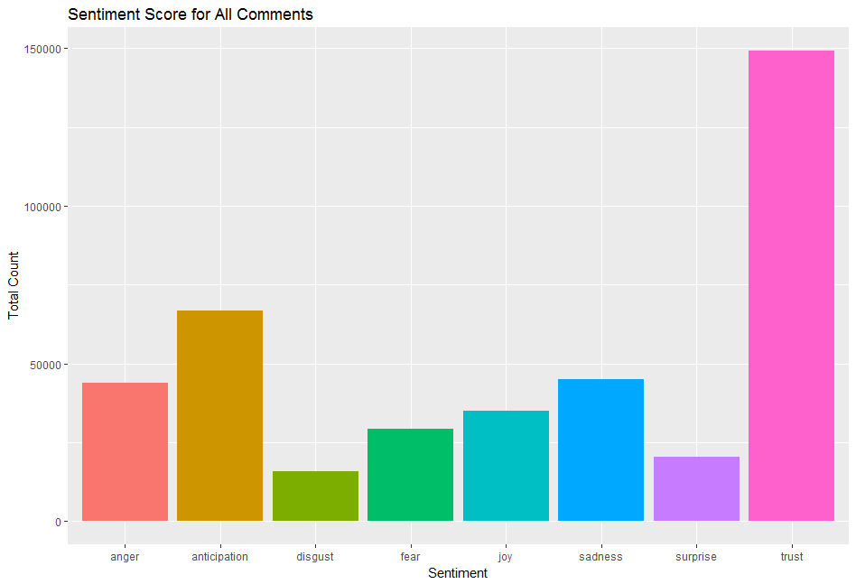
Sentiment Analysis
Even though there is a level of trust
It clear indicates that the overall customer responsiveness including the quality and speed of customer grievance tackling needs to be improved significantly.

Slide 13
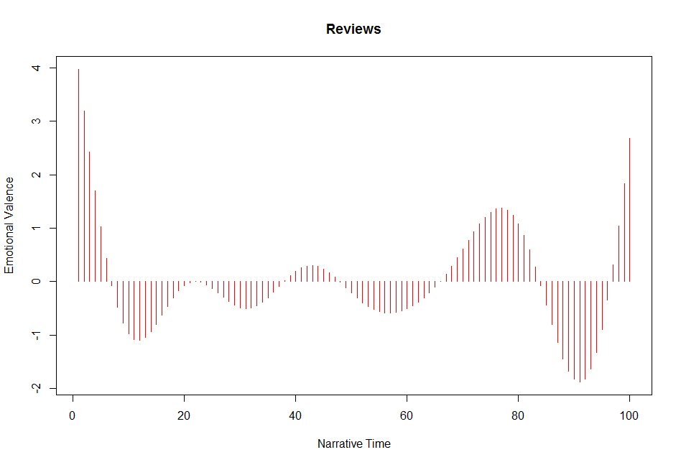
Sentiment Analysis
Customer Grievance Management has not been very consistent as we can see significant swings in the value of Emotional Valence.

Slide 14
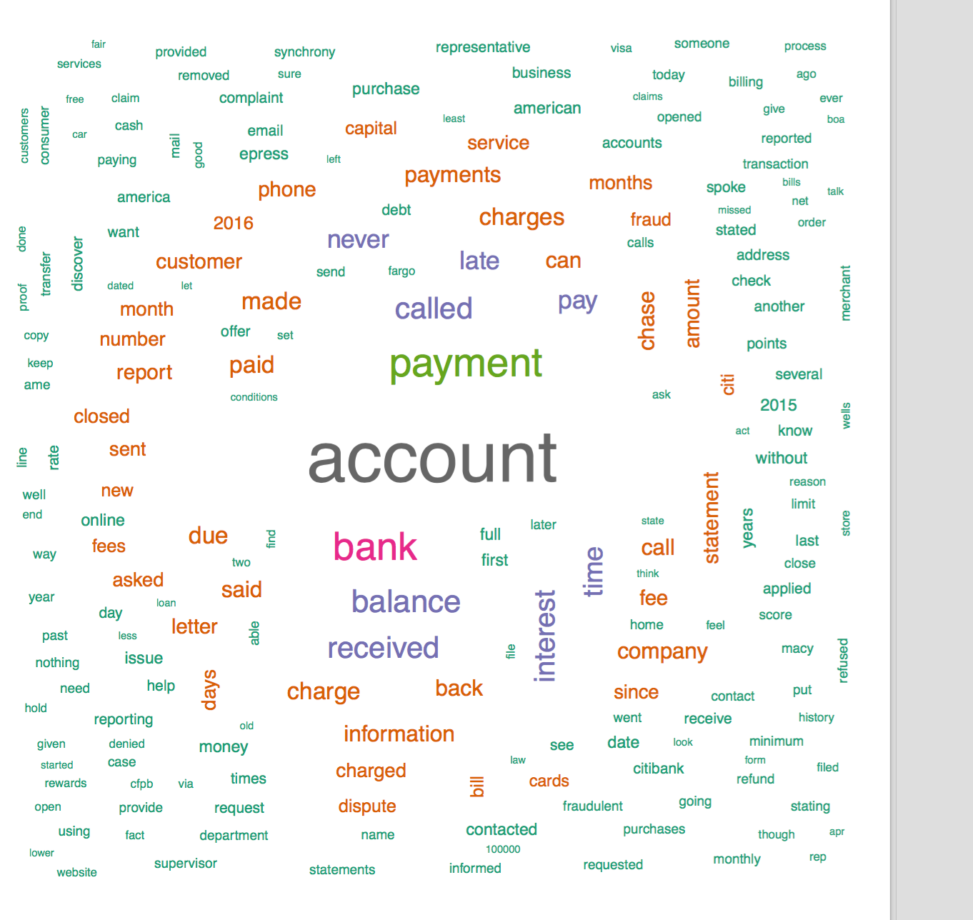
Word Cloud Analysis
Words like charge, payment, balance

Slide 15
Word Association Analysis
Capital
Balance
Dispute
.31
.27
.21
.17
.17
.19
.30
merchant
favor
.19
.18
charge
arguing
Number of complaints are regarding merchants charges, service is down
possessions
brake
paid
owed
Capital indicates the debt of consumer depicts frustration and assets.
outstanding
Any words aassociated hints there is still credit limit or balance were the frequently found in the database.

Slide 16
Insights Summary
Text Analysis
Complaint resolution times have improved
Customer misunderstanding may create more complaints than financial institution error
Troubled identity theft fraud charges, misrepresented charges, late fees, closing/cancelling account were the top main issues were behind the majority of the complaints- a growing trend
Credit decisions, including initial application decisions and servicing changes (e.g. interest rate adjustments, credit limit reductions) were frequently the subject of complaints.

Slide 17
Next Steps
Perform text analysis using Natural Language Processing (NLP) on the consumer complaints
Go on further depth analysis and getting insights from the consumer complaints in order to provide better ways improve the business process for the financial institutions
Investigate in more depth what is the majority of complaints using NLP

Slide 18
References
Kiefer, D., Stafford, T., Zagone, R., & Chiu,, J. (2017, September 13). CFPB's consumer complaint database Analysis reveal valuable insights. Retrieved June 7, 2017, from https://www2.deloitte.com/content/dam/Deloitte/us/Documents/financial-services/us-fsi-cfpb-consumer-complaint-database-091913.pdf
Consumers say financial institutions must get identity theft protection right. (2016, August 11). Retrieved May 03, 2017, from https://www.cbinsight.com/consumers-say-financial-institutions-must-get-identity-theft-protection-right.html
Chowdwary, R. (2016, February 04). Monthly Complaint Report . Retrieved May 04, 2017, from http://files.consumerfinance.gov/f/documents/201706_cfpb-Monthly-Complaint-Report-50-State.pdf
CFPB Monthly Snapshot Spotlights Credit Card Complaints. (2017, March 28). Retrieved May 04, 2017, from https://www.consumerfinance.gov/about-us/newsroom/cfpb-monthly-snapshot-spotlights-credit-card-complaints/
D. (2014, January 14). Leveraging the CFPB Complaint Database to Improve Business. Retrieved April 03, 2017, from http://deloitte.wsj.com/riskandcompliance/2014/01/15/leveraging-the-cfpb-complaint-database-to-improve-business/

